Slide 1
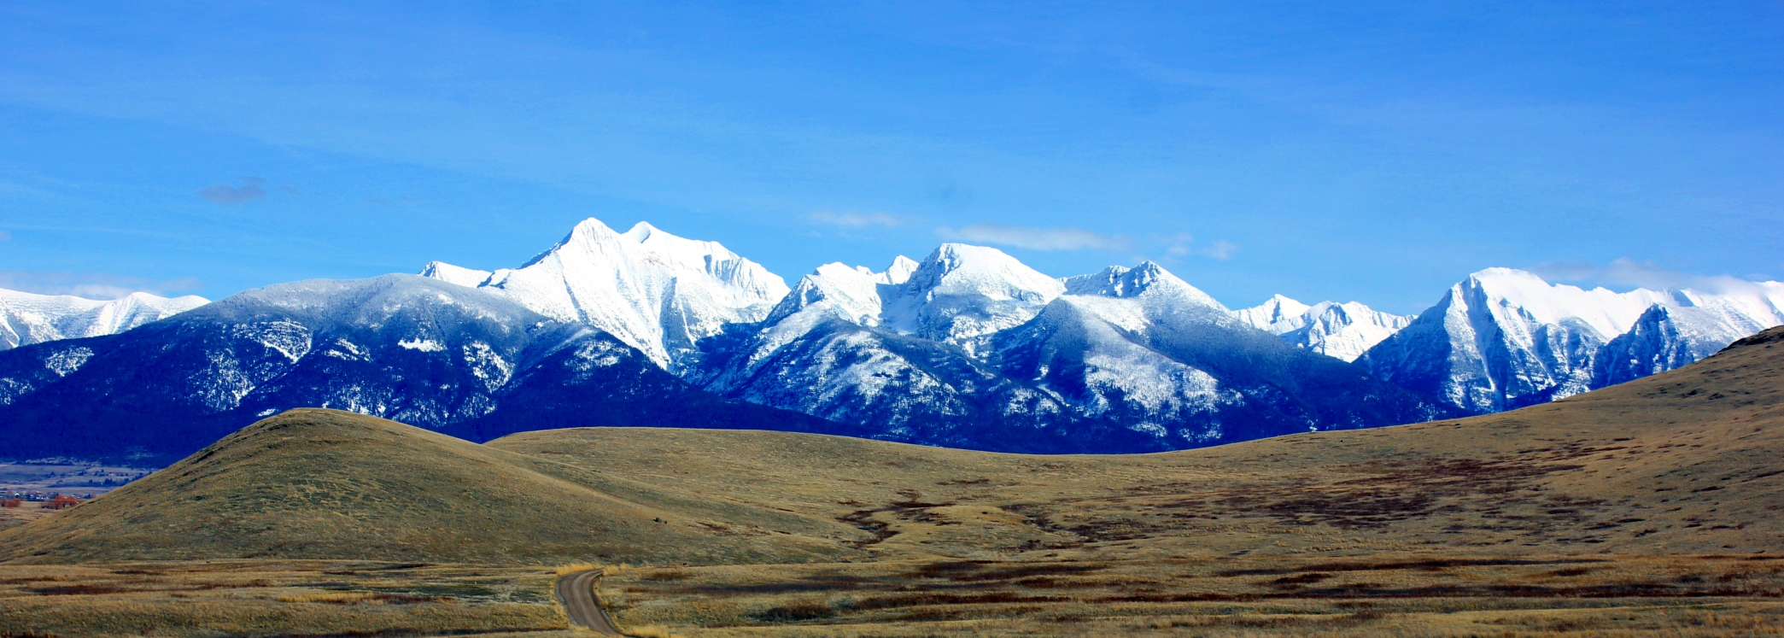
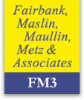
University of Montana Crown of the Continent and Greater Yellowstone Initiative
Key Findings from a Montana Statewide Survey
May 2016
Lori Weigel
Dave Metz
#16273

Slide 2
Methodology
N=500 interviews conducted with registered Montana voters
Statistically valid sample with an overall margin of sampling error of ±4.38% at the 95% confidence interval for the total sample.
Interviews conducted May 7th and 9th-11th, 2016

Slide 3
Montanans say conservation issues are important to their vote decision this election year.
Compared to other issues like the economy, health care and education, how important are issues involving clean water, clean air, open spaces and public lands for you in deciding whether to support an elected public official?
Very important; they are a primary factor in deciding whether to support an elected public official | 41%
Somewhat important; they are one of several issues you consider | 48%
TOTAL IMPORTANT | 88%
TOTAL NOT IMPORTANT | 11%
Not too important; they are not a significant factor considering in deciding whether to support an elected public official | 7%
Not at all important for you in deciding whether to support an elected official | 4%
*
* Denotes rounding

Slide 4
The importance of conservation issues extends across partisan lines.
Importance of Environmental Issues by Party
53%
Very
41%
Very
37%
Very
36%
Very
Compared to other issues like the economy, health care and education, how important are issues involving clean water, clean air, open spaces and public lands for you in deciding whether to support an elected public official? Are they…

Slide 5
Montanans’ Views of National Parks and Public Lands

Slide 6
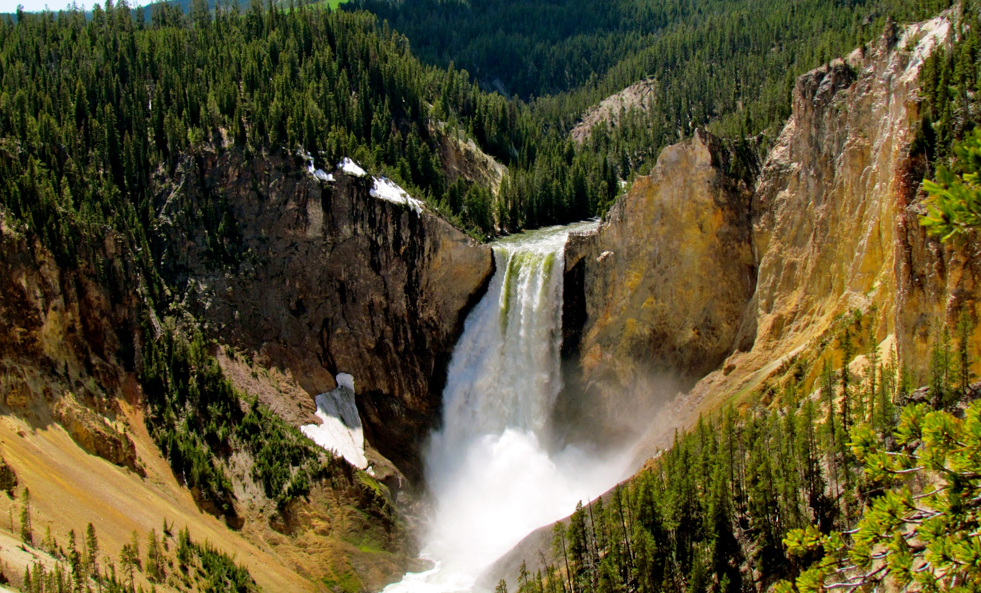
Four in five Montanans report visiting public lands and three-in-five a National Park in the last year; 95% who visited a National Park report a positive experience.
Overall Visitation
In the last twelve months, so since May 2015, have you visited any of the following?

Slide 7
National Parks are viewed as treasures which are critical to the economy and to future generations.
Phrases Ranked by % Very Well
% Very Well
% Total Well
Places I want my children and grandchildren to see someday
Critical to the economy of the communities nearby
National treasures
Critical to Montana’s economy
Places to learn about America’s history and heritage
I’m going to read you a list of words and phrases, and please tell me whether you think each one describes the national parks here in Montana. Does it describe it very well, somewhat well, not very well, or not at all?

Slide 8
They are also viewed as in need of additional resources and two-thirds say they are over-crowded.
Phrases Ranked by % Very Well
% Very Well
% Total Well
In need of additional resources to manage and protect them
Overcrowded
I’m going to read you a list of words and phrases, and please tell me whether you think each one describes the national parks here in Montana. Does it describe it very well, somewhat well, not very well, or not at all?

Slide 9
Voters say the National Park Service plays an equally or more important role today than ever.
Importance of National Park Service Today
As you may have heard, this year is the 100th anniversary of the founding of the National Park Service which manages the National Parks like Glacier and Yellowstone as well as many historic and cultural sites like the Little Bighorn Battlefield here in our state…
+27%
Would you say that the work of the National Park Service at our National Parks and historic and cultural sites is more important today than in the past, less important today than in the past, or equally as important today as in the past?

Slide 10
Montanans are increasingly likely to say public lands broadly provide many positive benefits.
Items Ranked by 2016 Positive Impact
Positive Impact
No Impact
Negative Impact
Opportunities for children to explore and learn about nature
June 2014
May 2016
Wildlife
June 2014
May 2016
Tourism
June 2014
May 2016
Protecting clean water
June 2014
May 2016
Maintaining what is best about Montana
June 2014
May 2016
Taking a step back and thinking about all publicly owned lands -- Generally speaking, do you believe enhancing and protecting public lands, such as local, state and national parks, national forests, and wilderness has a positive impact, a negative impact, or no real impact on each of the following:

Slide 11
The economic impact of public lands is seen as on par with many other benefits today.
Items Ranked by 2016 Positive Impact
Positive Impact
No Impact
Negative Impact
The overall quality of life in Montana
June 2014
May 2016
Protecting our culture and heritage
June 2014
May 2016
Opportunities for hunting, fishing, and outdoor recreation
June 2014
May 2016
Jobs and the economy
June 2014
May 2016
Protecting clean air
June 2014
May 2016
Taking a step back and thinking about all publicly owned lands -- Generally speaking, do you believe enhancing and protecting public lands, such as local, state and national parks, national forests, and wilderness has a positive impact, a negative impact, or no real impact on each of the following:

Slide 12
In fact, the economic impact of public lands is far more likely to be recognized today.
Change in Positive Impact (2016-2014)
Jobs and the economy
Protecting our culture and heritage
Opportunities for children to explore and learn about nature
Wildlife
Protecting clean water
The overall quality of life in Montana
Protecting clean air
Tourism
Maintaining what is best about Montana
Opportunities for hunting, fishing, and outdoor recreation
Taking a step back and thinking about all publicly owned lands -- Generally speaking, do you believe enhancing and protecting public lands, such as local, state and national parks, national forests, and wilderness has a positive impact, a negative impact, or no real impact on each of the following:

Slide 13
Montanans On National Public Lands Policy

Slide 14
Three-quarters of Montana voters support the Blackfoot Clearwater Stewardship Project.
Blackfoot Clearwater Stewardship Project
The Blackfoot Clearwater Stewardship Project in western Montana would ensure access to hunting and fishing sites, increasing protections for approximately eighty five thousand acres of existing public lands by adding them to the Bob Marshall, Scapegoat and Mission Mountains wilderness areas; open a high quality area for snowmobiling, and maintain timber harvesting. Do you support or oppose this project?
+56%
35%
Strongly
11%
Strongly
Thinking more specifically about some proposals here in Montana that would affect public lands – for each one, please tell me whether it sounds like something you would support or oppose.

Slide 15
There is no partisan distinction whatsoever in support for this project.
Blackfoot Clearwater Stewardship Project by Party
+53%
+61%
+50%
35%
Strongly
37%
Strongly
29%
Strongly
Thinking more specifically about some proposals here in Montana that would affect public lands – for each one, please tell me whether it sounds like something you would support or oppose.

Slide 16
Seven-in-ten Montana voters are opposed to allowing oil and gas drilling in the Badger Two Medicine area.
Decades ago, the federal government sold leases allowing oil and gas companies to drill on public lands in what is called the Badger-Two Medicine area of Lewis and Clark National Forest, which connects Glacier National Park and the Bob Marshall Wilderness. The Blackfeet Indian tribe were not included in the original decisions to sell the leases and object as they consider this area to be sacred land. Do you support or oppose allowing oil and gas drilling in the Badger-Two Medicine area?
Badger-Two Medicine Area Leases
-45%
49%
Strongly
12%
Strongly
Thinking more specifically about some proposals here in Montana that would affect public lands – for each one, please tell me whether it sounds like something you would support or oppose.

Slide 17
Voters across the political spectrum are more likely to oppose energy leases in this area.
Badger-Two Medicine Area Leases by Party
-6%
-47%
-89%
71%
Strongly
53%
Strongly
22%
Strongly
24%
Strongly
10%
Strongly
Thinking more specifically about some proposals here in Montana that would affect public lands – for each one, please tell me whether it sounds like something you would support or oppose.

Slide 18
Vast majority feel resource extraction is not acceptable on lands important to Native Americans or recreationalists.
Locations Ranked by % Not Appropriate
Appropriate
On public lands that are considered sacred sites to Native Americans
-57%
Not Appropriate
Appropriate
On public lands near national parks
-28%
Not Appropriate
Appropriate
On public lands that are frequently used by outdoor recreationists like hunters, anglers, or hikers
-27%
Not Appropriate
Appropriate
On public lands near farms and ranches
+8%
Not Appropriate
Appropriate
On public lands that are not environmentally sensitive
+50%
Not Appropriate
Thinking about the government practice of allowing companies to lease some national public lands to drill and mine for oil, natural gas, coal and other minerals – For each of the following types of areas, please tell me if you think that is an appropriate or not appropriate place to allow drilling or mining.

Slide 19
Three-in-five voters oppose the new mines near Yellowstone.
Two new mines have been proposed in the Paradise Valley, within a few miles of the northern entrance to Yellowstone National Park and upstream of the Yellowstone River. These new sulfide mining operations would be used to extract gold from underground rock formations containing sulfur. Do you support or oppose allowing these new mining operations?
Two New Mines
-27%
41%
Strongly
16%
Strongly
Thinking more specifically about some proposals here in Montana that would affect public lands – for each one, please tell me whether it sounds like something you would support or oppose.

Slide 20
A majority is opposed in every major area of the state.
Mining by Region
Great Falls (16%)
Support | Oppose
38% | 55%
Missoula (31%)
Support | Oppose
30% | 66%
Billings (22%)
Support | Oppose
40% | 55%
Butte (17%)
Support | Oppose
21% | 74%
Thinking more specifically about some proposals here in Montana that would affect public lands – for each one, please tell me whether it sounds like something you would support or oppose.

Slide 21
By a 16 point margin, voters side with opponents of the new mines near Yellowstone.
Some people say that we should oppose these new mines, because they are located upstream of the Yellowstone River in an area that is important for wildlife and a gateway for visitors which many local businesses rely upon. Gold mines have a bad track record of leaving taxpayers on the hook to clean up toxic metals from our lands and allowing toxins like sulfuric acid into our waters. Montana is growing its economy because of recreation and our natural beauty. We should not risk allowing more industrial mining.
56%
Other people say that they support the new mines because many Montanans are struggling to get by and we need economic opportunities that will create good-paying jobs, rather than low-wage, service jobs. Besides mining has come a long way, and it is now possible to safely mine using modern technology, advanced water treatment systems and other safeguards for the environment.
40%
Thinking more about whether or not to allow new gold mines within a few miles of the northern entrance to Yellowstone National Park – There are different viewpoints about this issue. Please indicate which one comes closest to your view, even if neither matches what you think exactly.

Slide 22
A majority of voters oppose state takeover
of national public lands.
Some elected officials have proposed giving Montana state government control over national public lands, such as national forests, national monuments, and national wildlife refuges in its borders. The state government would decide the future management of the lands, and Montana taxpayers would pay the costs, including maintenance, invasive weed control and fighting wildfires. Do you support or oppose giving state government control over national public lands?
State Control of National Public Lands
-14%
38%
Strongly
19%
Strongly
Thinking more specifically about some proposals here in Montana that would affect public lands – for each one, please tell me whether it sounds like something you would support or oppose.

Slide 23
Opposition extends across the state.
State Control of National Public Lands by Region
Great Falls (16%)
Support | Oppose
41% | 56%
Missoula (31%)
Support | Oppose
45% | 52%
Billings (22%)
Support | Oppose
39% | 58%
Butte (17%)
Support | Oppose
34% | 62%
Thinking more specifically about some proposals here in Montana that would affect public lands – for each one, please tell me whether it sounds like something you would support or oppose.

Slide 24
The Bottom Line

Slide 25
The Bottom Line
Montanans are avid users of national public lands, and nearly all of them have visited the two National Parks in the state. They overwhelmingly report positive experiences there, and attribute many positive qualities of National Parks being in the state. That said, the vast majority believe National Parks are in need of additional funds to manage and preserve the Parks.
The state’s electorate also weighed in on a number of current policy decisions affecting public lands in the state. Specifically, they…
Overwhelmingly support the Blackfoot Clearwater Stewardship project;
Oppose drilling in the Badger Two Medicine area;
Oppose new mines near Yellowstone National Parks;
Oppose state takeover of national public lands, although some ideological distinction.

Slide 26
Lori Weigel
lori@pos.org | (303) 324 7655

